Slide 1
Group 5
CAPSTONE PROJECT
VIETNAMESE SIGN
LANGUAGE RECOGNITION
ALLPPT.com _ Free PowerPoint Templates, Diagrams and Charts

Slide 2

Introduction
Group member :
Nguyễn Hữu Kỳ Long – Team leader
Nguyễn Đình Tân – Team member
Nguyễn Xuân Ý – Team member
Lê Phương Bình – Team member
Supervisor :
Mr. Đỗ Đức Minh Quân

Slide 3
Outline
Scenario problem
Our solution
System overview
Overview components
Overview hand gesture recognition algorithm
Development tool
Future plan
Features and Demo

Slide 4

Scenario problem
The speak language is the common way to communicate in life.
Dumb person must use other way to communicate, it is called hand sign language.
Ordinary people talking to one person or a mute like to present / his ideas, presented in a meeting, but they could not understand each other's language.
Two dumb person talk with each other but they have distinct hand sign language, which way can they understand each other’s sign.

Slide 5


Our solution
Using hand gesture recognition. Translating hand signs into content and then show them.
Small device has camera can capture hand signs and then translate them into text or sound with the same meaning.

Slide 6
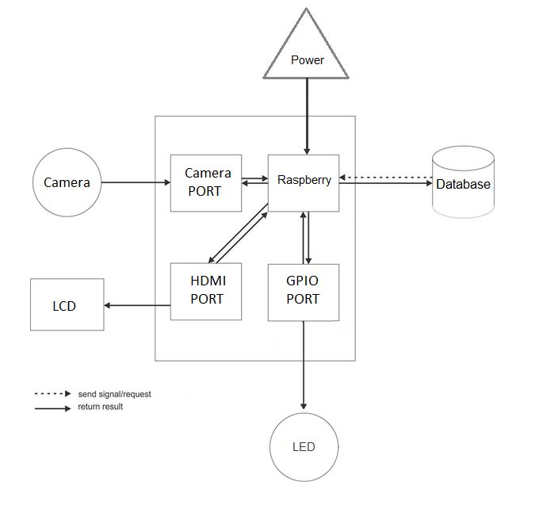

System overview

Slide 7
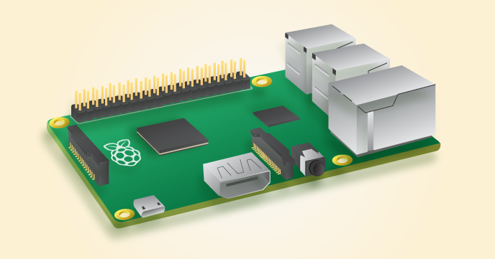
Overview components
Raspberry Pi B2
SoC: Broadcom 2836
CPU: Quad-core ARM7 800MHz
GPU: Videocore IV 250MHz
Memory: 1GB
GPIO: 40pin
Ports: 4x USB 2.0, 100BaseT Ethernet, HDMI, MicroSD card
Size: 85.60 × 56.5mm (about 3.2 x 2.1-inch)

Slide 8
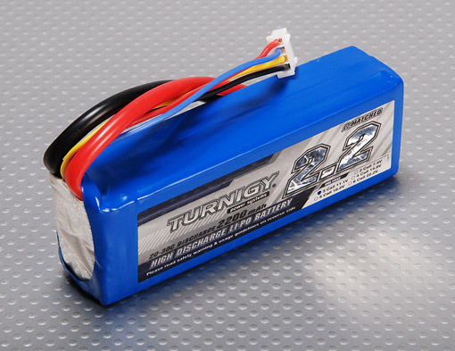
Overview components (Cont)
Lipo Battery
Minimum Capacity: 2200mAh (True 100% Capacity)
Configuration: 3S1P / 11.1v / 3Cell
Constant Discharge: 20C
Peak Discharge (10sec): 30C
Pack Weight: 188g
Pack Size: 103 x 33 x 24mm
Charge Plug: JST-XH
Discharge Plug: XT60

Slide 9
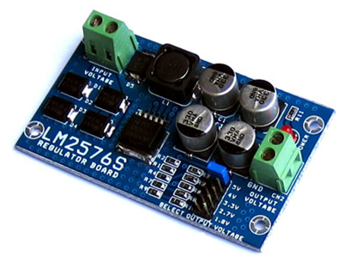
Overview components (Cont)
LM2576ADJ - 3A UNI REG Board
UNI-REG board allows changing voltages from 7-23V AC (or 9-32V DC) to 5V, 4V, 3.3V, 2.7V or 1.8V.
Circuit Board using LM2576 - Step-Down Voltage Regulator.
On-board screw-terminals are available for easy connection.
Notes:
Sử dung IC ổn áp LM2596S-ADJ
Điện áp đầu vào: 7-21 VAC hoặc 9-32 VDC
Điện áp đầu ra: 5.0V, 4.0V, 3.3V, 2.7V và 1.8V, Lựa chọn bằng Jumper
Dòng tải: max 3.0 Ampere
Board mạch 2 lớp chất lượng cao, dòng tải lớn
Kích thước board: 45 x 77 mm, có 4 lỗ 3.2 mm thuận lợi cho việc lắp đặt và cố định board
Có sẵn mạch chỉnh lưu cầu 4 Diode tốc độ cao, không cần phân biệt AC/DC và cực tính DC đầu vào

Slide 10
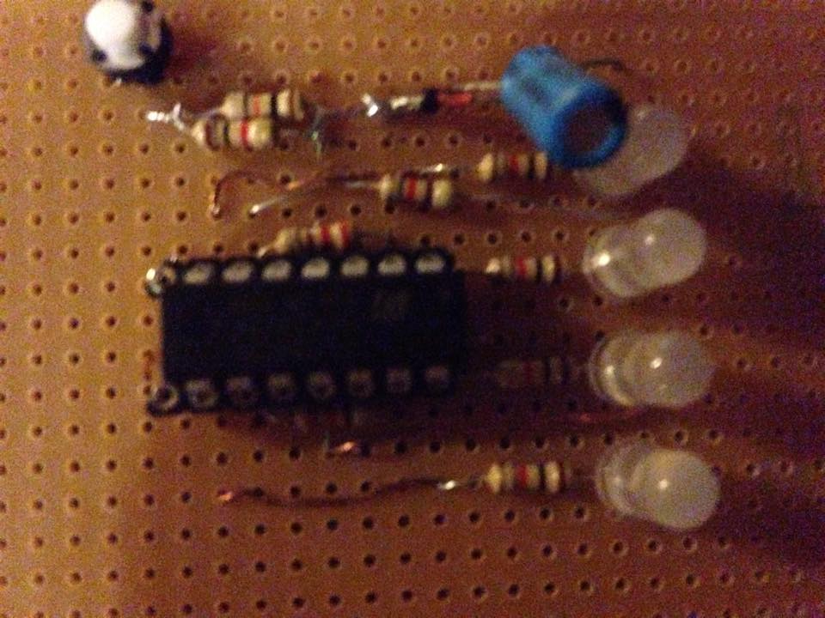
Overview components (Cont)
Circuit display the battery capacity via LED
UNI-REG board allows changing voltages from 7-23V AC (or 9-32V DC) to 5V, 4V, 3.3V, 2.7V or 1.8V.
Circuit Board using LM2576 - Step-Down Voltage Regulator.
On-board screw-terminals are available for easy connection.

Slide 11
Overview hand gesture recognition algorithm
Operating principles of hand gesture recognition
All images of hand sign about a letter in Alphabet must have same ID.
Training hand sign database before recognition.
Hand sign recognition and return.

Slide 12
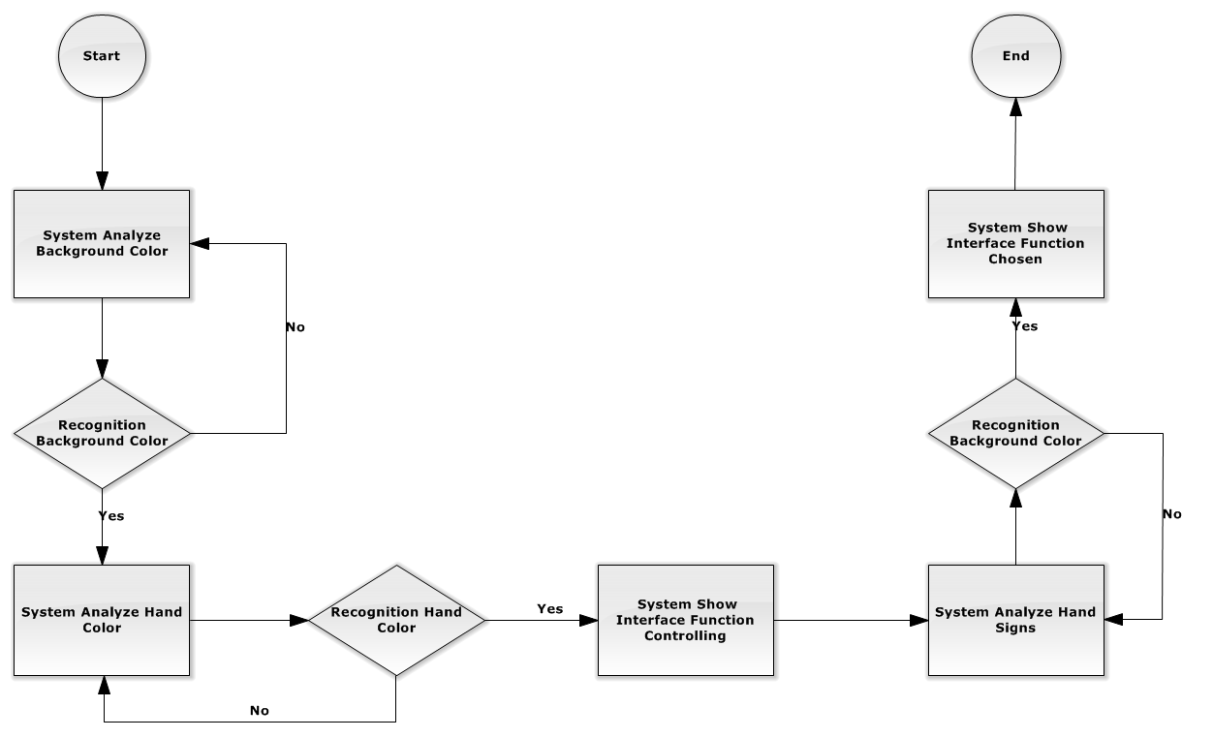
Overview hand gesture recognition algorithm
Image processing flowchart

Slide 13
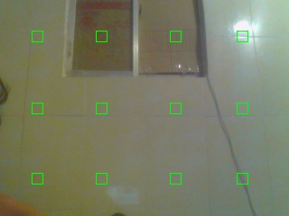


Overview hand gesture recognition algorithm
Hand sign recognition processing
Capture background to sampling background color

Slide 14
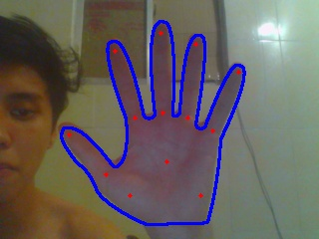


Overview hand gesture recognition algorithm
Hand sign recognition processing
Capture hand to sampling front hand color

Slide 15
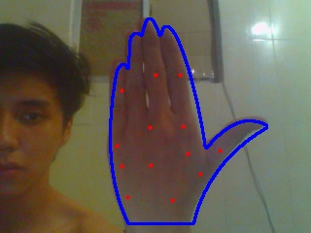


Overview hand gesture recognition algorithm
Hand sign recognition processing
Capture hand to sampling back hand color

Slide 16



Overview hand gesture recognition algorithm
Hand sign recognition processing
Background subtraction skin color extraction

Slide 17



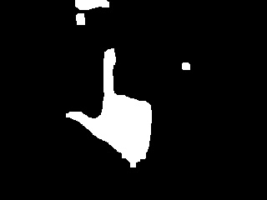
Overview hand gesture recognition algorithm
Hand sign recognition processing
Hand subtraction skin color extraction

Slide 18



Overview hand gesture recognition algorithm
Hand sign recognition processing
Features extraction

Slide 19
Development tool

Slide 20
Future plan

Slide 21
Features and Demo

